Slide 1
Content Based Recommendation

Slide 2
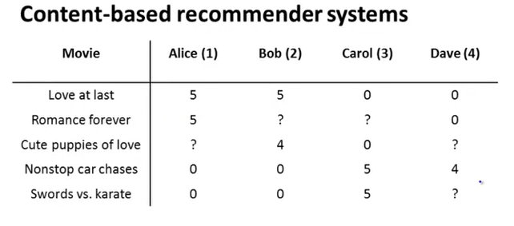
Problem Statement
Predict Missing Value

Slide 3
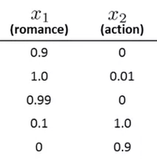

Problem Statement
$$x_{0} =1$$
Feature of each movie
Predict Missing Value

Slide 4




Problem Statement
$$x_{0} =1$$
$$θ_{1}$$
$$θ_{2}$$
$$θ_{3}$$
$θ_{4}$
Feature of each movie

Slide 5

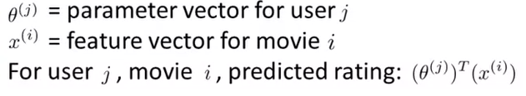
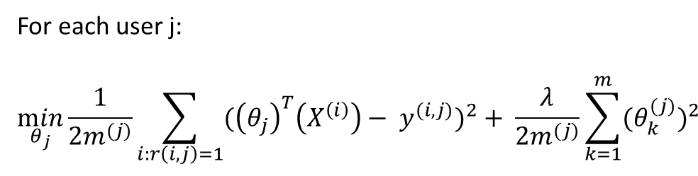
Problem Formulation
For each user j:
$$\min_{θ_{j}}{\frac{1}{2m^{(j)}}\sum_{i:r\left(i,j\right)=1}{{({\left(θ_{j}\right)}^{T}\left(X^{\left(i\right)}\right)− y^{(i, j)})}^{2}}+ \frac{λ}{2m^{(j)}}\sum_{k=1}^{m}{{{(θ}_{k}^{(j)})}^{2}}}$$

Slide 6
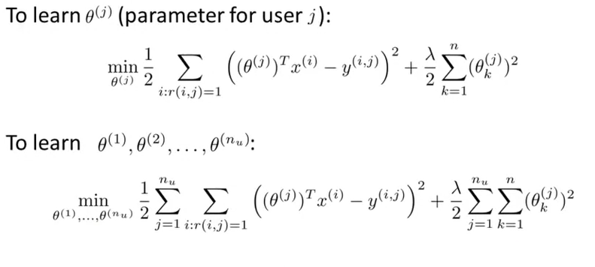
Optimization Objective

Slide 7
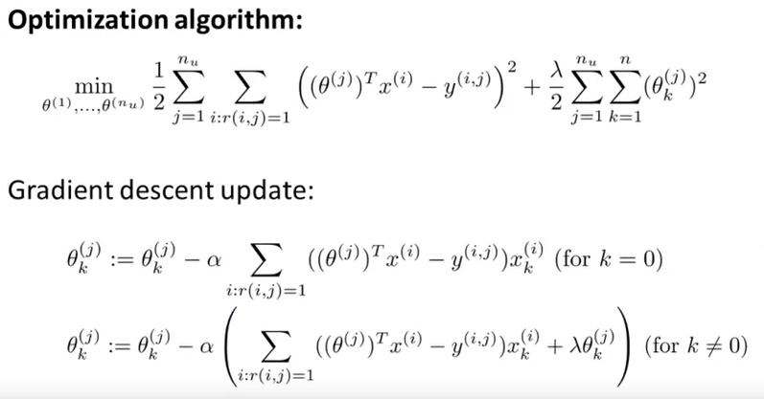
Optimization Objective

